Slide 1


FeliXSim:
An Interactive Simulation Environment for Global Systems Modeling in Climate and Sustainability Contexts
Ryan Tan*, Sibel Eker
Sustainable Service Systems Research Group
Energy, Climate, and Environment Program
International System Dynamics Conference 2026
Notes:
Flow of the Conversation:
Why Interactive Simulators
What is FeliXSim? Model + Interface
Presentation of Tool
Discussions

Slide 2
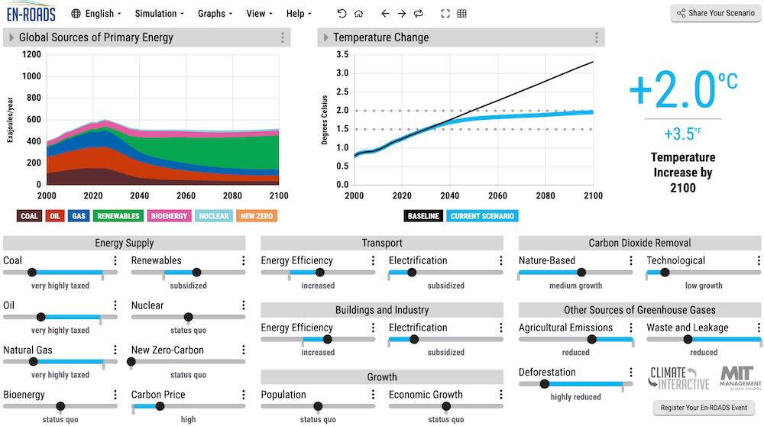
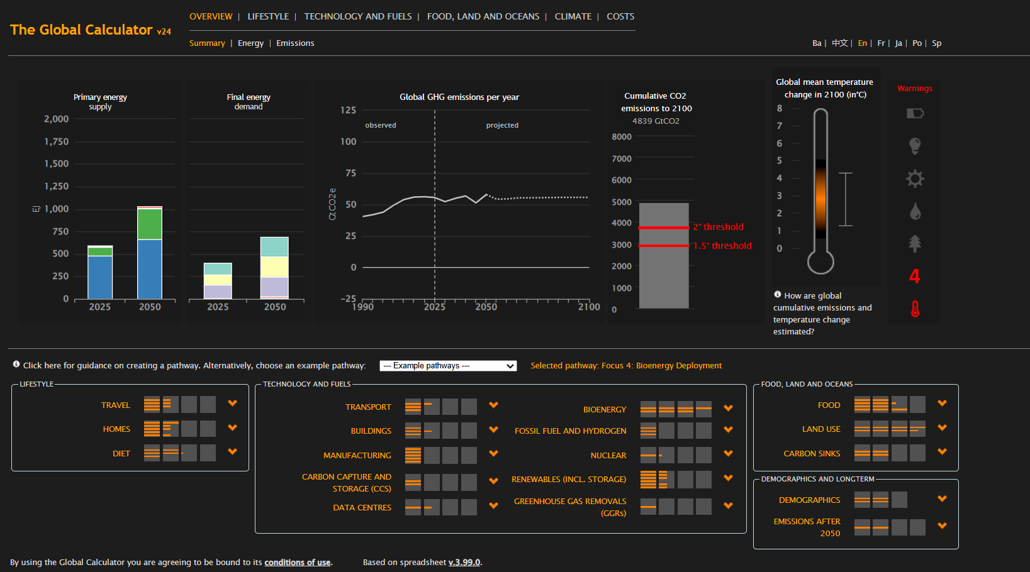
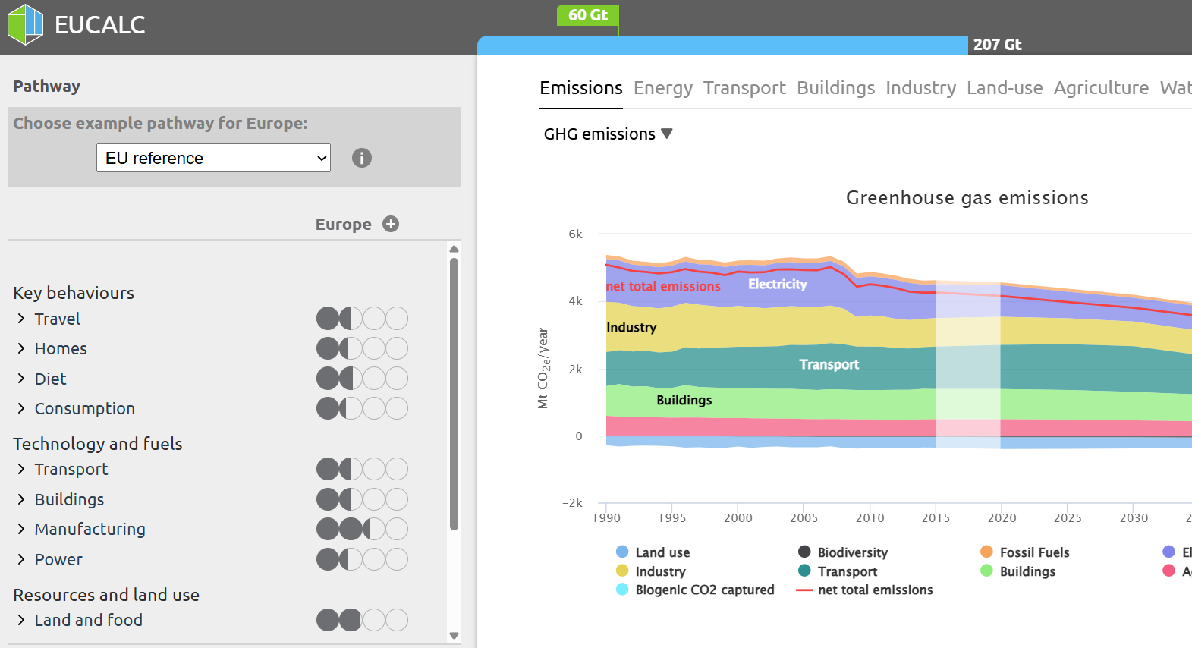
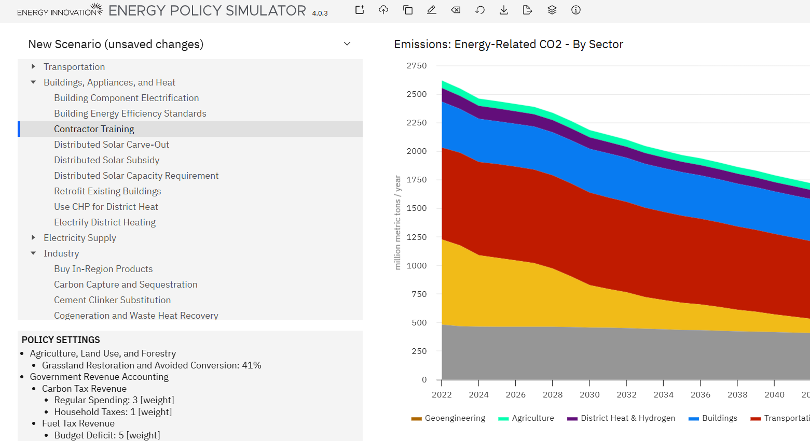
What are “Interactive Simulators”?
En-ROADS
The Global Calculator
EUCalc
Energy Policy Simulator

Slide 3
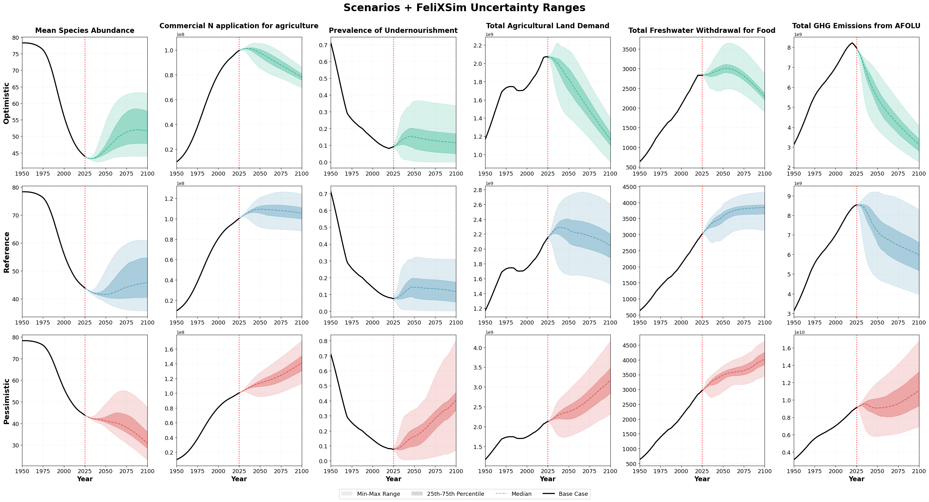
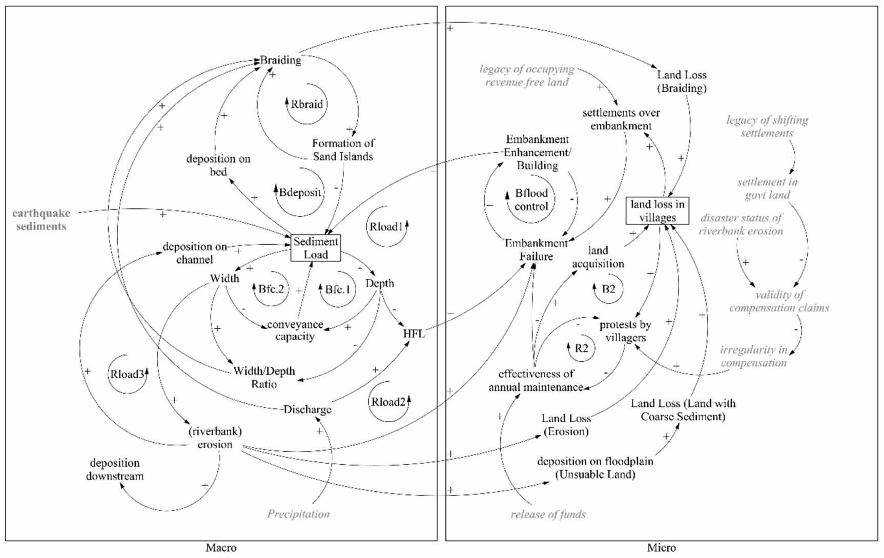
Why Interactive Simulators?
Changing Roles of (Integrated Assessment) Models
(Van Beek et al., 2020)
  Global models are crucial for decision-making
  Implementation is a focus, and not the most inclusive due to accessibility gaps
Addressing the Intention-Action Gap
(UNESDOC, 2024)
  Knowledge doesn’t translate to sustained actions
  Social, emotional, action-oriented learning needed
Tl;dr: Better Engagement!
Notes:
Important because of changing climate discourse.

Slide 4
Goal for FeliXSim
Non-expert Engagement
Accessible for non-experts to explore scenarios
Engagement on emotions, values and motivations
Scientifically Rigorous
Constantly updated to literature
Aligned to scientific/policy discourse
Interactive Simulator for the Food System
One of the largest drivers of environmental change
Consumer Perspective: Individuals hold the greatest impact-mitigation option (diet, food waste)

Slide 5
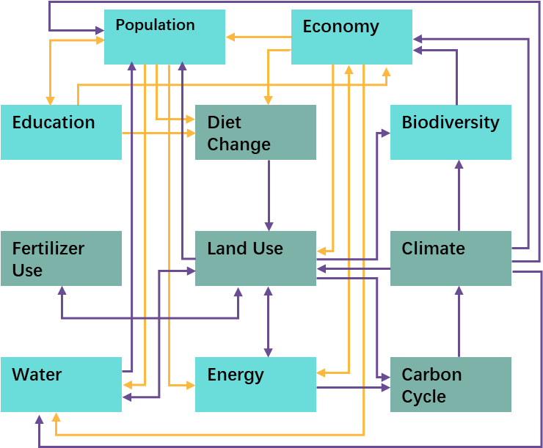


Development of FeliXSim?
FeliX v26 (Vensim Model) (IIASA, 2024)
System dynamics-based global IAM (1900 to 2100)
Includes nine modules to represent the dynamic Earth-Human system with feedback loops within and between them
FeliXSim (Web Interface)
Configure variables flexibly into an input-output format; scoped to food systems
Interactive elements for scenario exploration
Web Tech: WebAssembly, jQuery, Chart.js, etc
System Outcomes
Food
Nutrition
Land Use
Climate
Fertilizer
Biodiversity
Water
Scenario Inputs
Consumption
Production
Uncertainties
External Drivers
FeliX IAM
(Simulated in Real Time)
Undergoing Development in Parallel

Slide 6
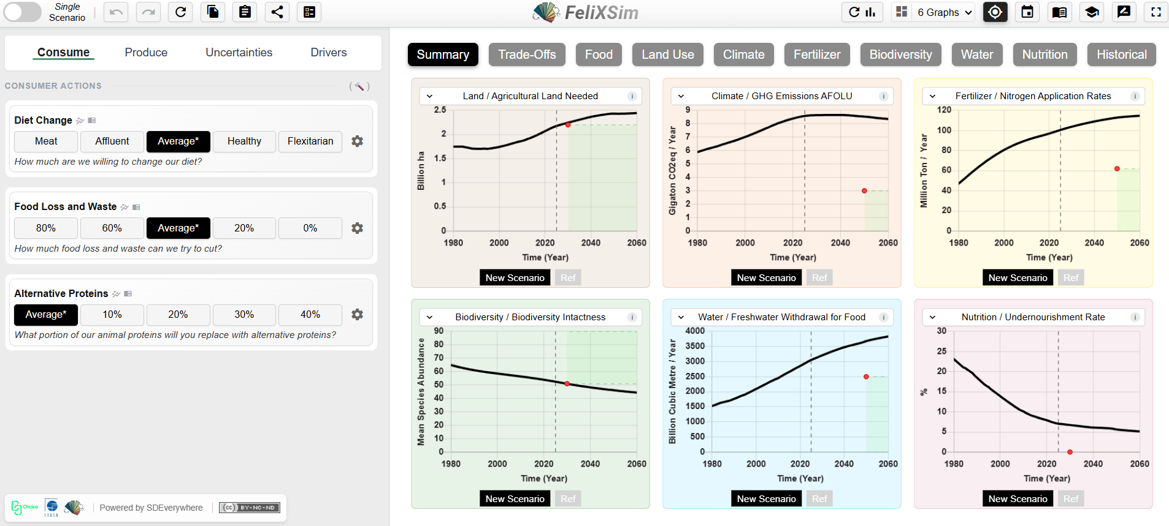
Interface Design of FeliXSim and Key Features
Notes:
Presentation – Framing of Scenarios, Trade-offs, Deeper Exploration.
Key Features – Individual, self-guided; Collective,

Slide 7
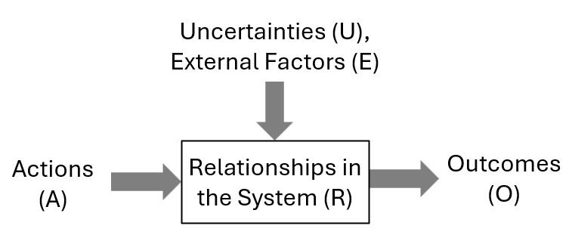
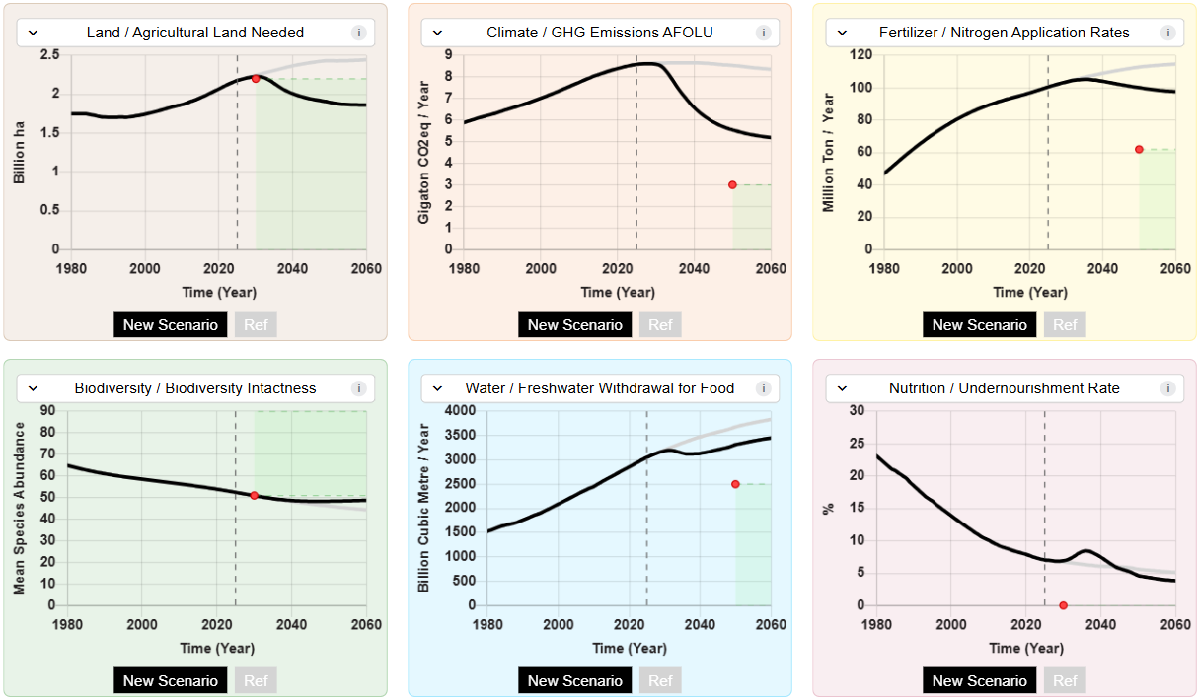
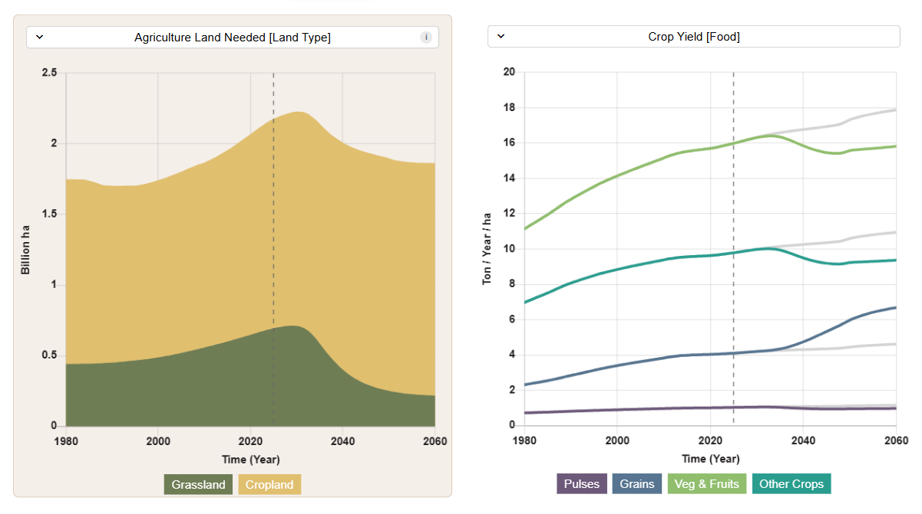
Content Design
Impact-based Scenarios
Focusing on synergies, trade-offs, and target alignments
“If I were to change my diet, how does it influence the various sustainability outcomes?
Uncertainties-based Scenarios
Focusing on impact pathways, behaviour drivers and technological change
“What are the behavioral drivers of large-scale diet change?”
Notes:
Important because of changing climate discourse.

Slide 8

Final Remarks
Interactive simulators allows the best of both worlds – 1) scientific rigour of
model frameworks, but 2) non-expert engagement from interface/feature design.
FeliXSim contributes an interactive simulator for the food system.
There is always more potential to make models more engaging.

Slide 9
Thank You!
!!!
Workshop:
Low-carbon behavior changes:
Exploring food system scenarios with FeliXSim
TPM Hall G
Friday
10:30 AM – 12:00 PM
Thread: Environment and Resources,
Duration: 90 minutes
Chair: Sibel Eker
!!!
Please reach out if you have any Questions!
RYAN TAN
Energy, Climate and Environment
tanryan@iiasa.ac.at

Slide 10
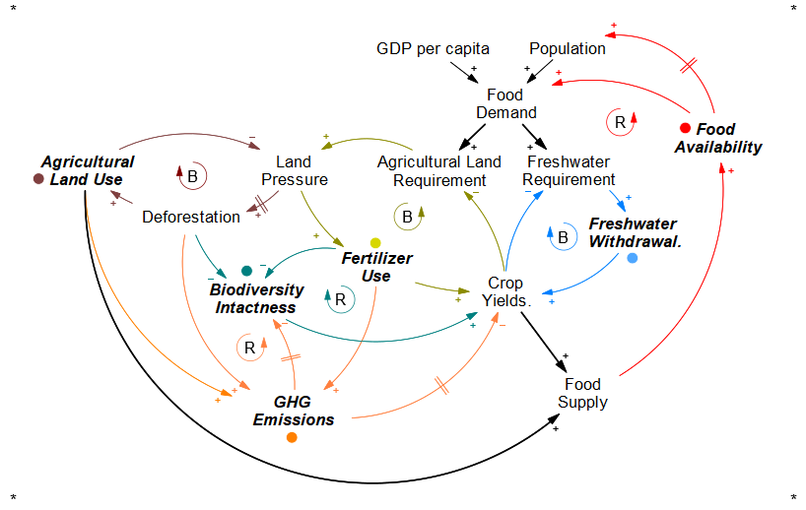
Conceptualisation of the Food System

Slide 11
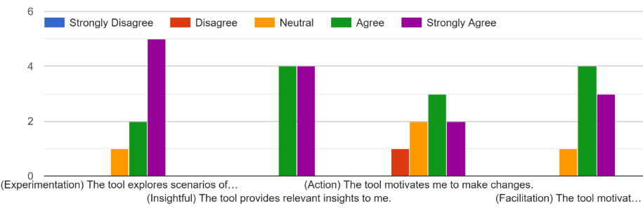
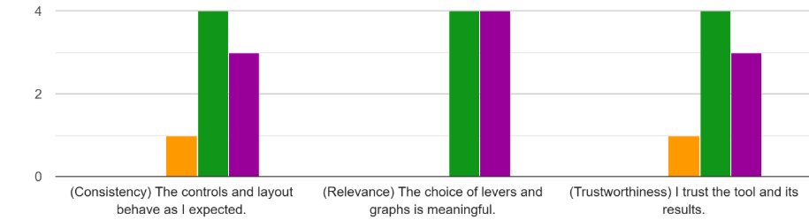
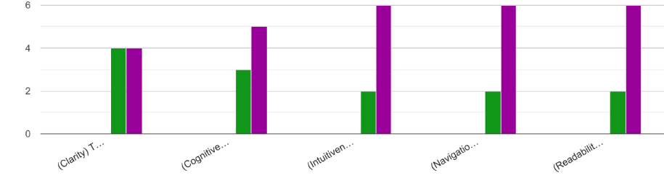
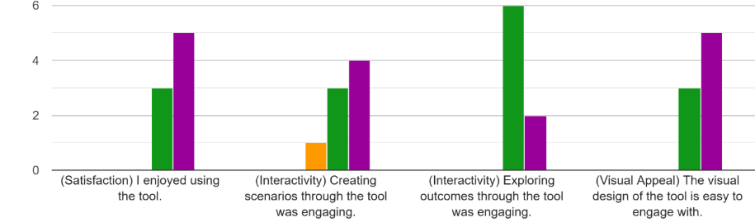
Usefulness
Credibility
Accessibility
Engagement

