Slide 1

Influence of Feedbacks in Food System Models:
Exploring the Relevance of Biodiversity and Other Cross-System Feedbacks
Ryan Yi Wei Tan
Quanliang Ye
Sibel Eker
Sustainable Service Systems, IIASA

Slide 2
Food System?
Isn’t this a Biodiversity Conference??
The food system is a key policy space for both climate and biodiversity.
Existing models are biased towards climate (Neumann et al. 2026).
Models should support a more integrated perspective for biodiversity and other sustainability outcomes.

Slide 3
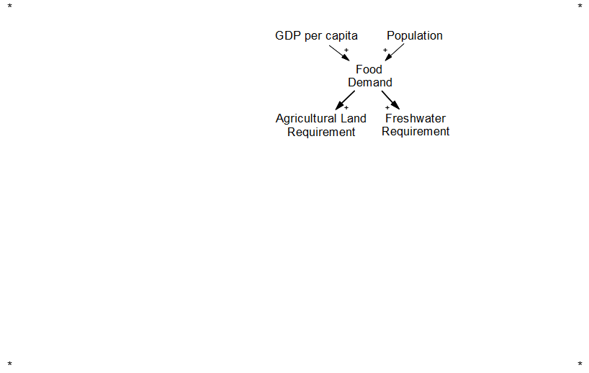
Conceptualisation of the Food System
Food Demand

Slide 4
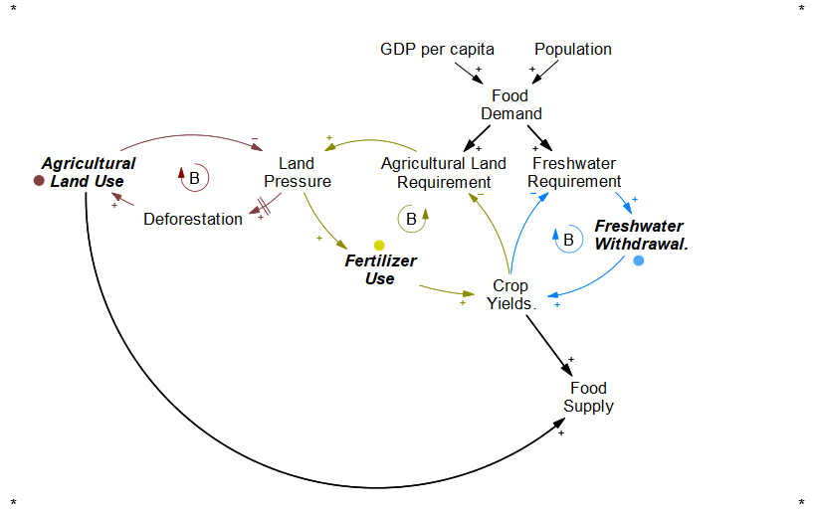
Conceptualisation of the Food System
Agricultural Resource Allocation
1) Water Stress Response ⦿
(Yield → Water Use → Yield)
2) Land Use Response ⦿
(Yield → Land Use → Yield)
3) Fertiliser Intensification ⦿
(Yield → Fertiliser Use → Yield)

Slide 5
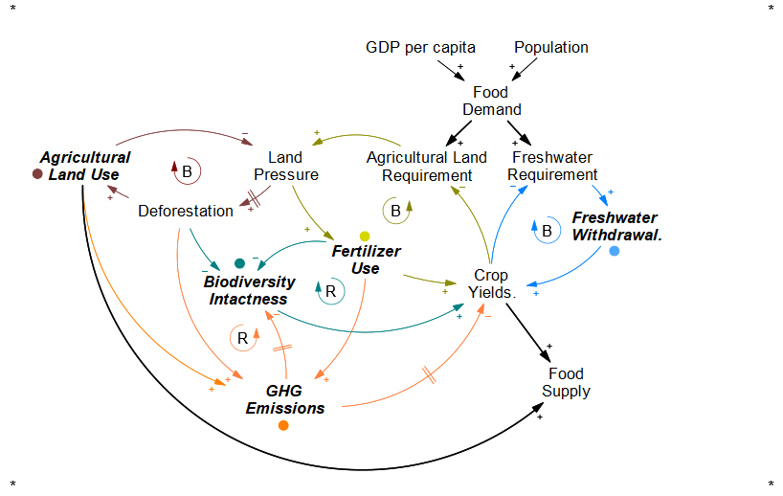
Conceptualisation of the Food System
Environmental Feedbacks
4) Biodiversity Feedback ⦿
(Biodiversity → Yields → …)
5) Climate Feedbacks ⦿
(Temperature → Yield → …)
(Carbon → Yield → …)

Slide 6
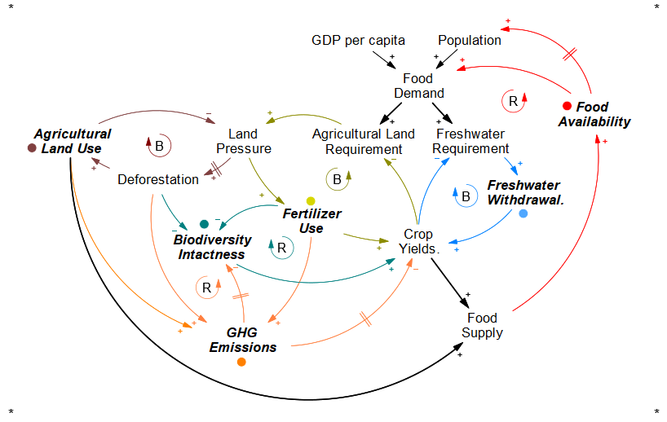
Conceptualisation of the Food System
Socioeconomic Feedbacks
6) Market Feedback ⦿
(Supply → Price → Demand)
7) Population Feedback ⦿
(Supply → Availability → Population)

Slide 7
Limitations in Model Structures and Representation
Models’ differing structures biases towards their priorities
(Neumann et al., 2026)
Biodiversity is largely an endpoint, not a key driver;
(Kim et al., 2025)
Limitations in model representation are a source
of bias and uncertainty.
Economic Models (CGEs)
Biophysical Crop Models
Earth System Models
Notes:
Visualization of Existing Fragmentation.

Slide 8
What will we learn from having a fuller picture?
Notes:
We know that we have an incomplete picture because of these structural differences.
So what our work tries to do is test it out and see what can we understand system behvioru

Slide 9
Experimental Setup
FEEDBACKS* as INPUTS
*Relatively underexplored feedbacks
Biodiversity-Yield Feedback
Climate-Yield Feedback
Water-Yield Feedback
Land-Fertiliser Intensification
Food-Population Feedback
Varying from “full feedback” to “no feedback”
OUTCOMES as OUTPUTS
(Biodiversity) Species Abundance
(Climate) GHG Emissions AFOLU
(Water) Freshwater Withdrawal
(Land Use) Agriculture Land Demand
(Fertilizer) Nitrogen Application
(Nutrition) Caloric Availability
Global Sensitivity Analysis
FeliX
“Simple” IAM
System Dynamics-based IAM.
Sobol Sampling n= 100,000
Notes:
Biodiversity Feedback
Climate Feedback
3) Water Stress Feedback
4) Fertiliser Intensification
5) Population Feedback

Slide 10
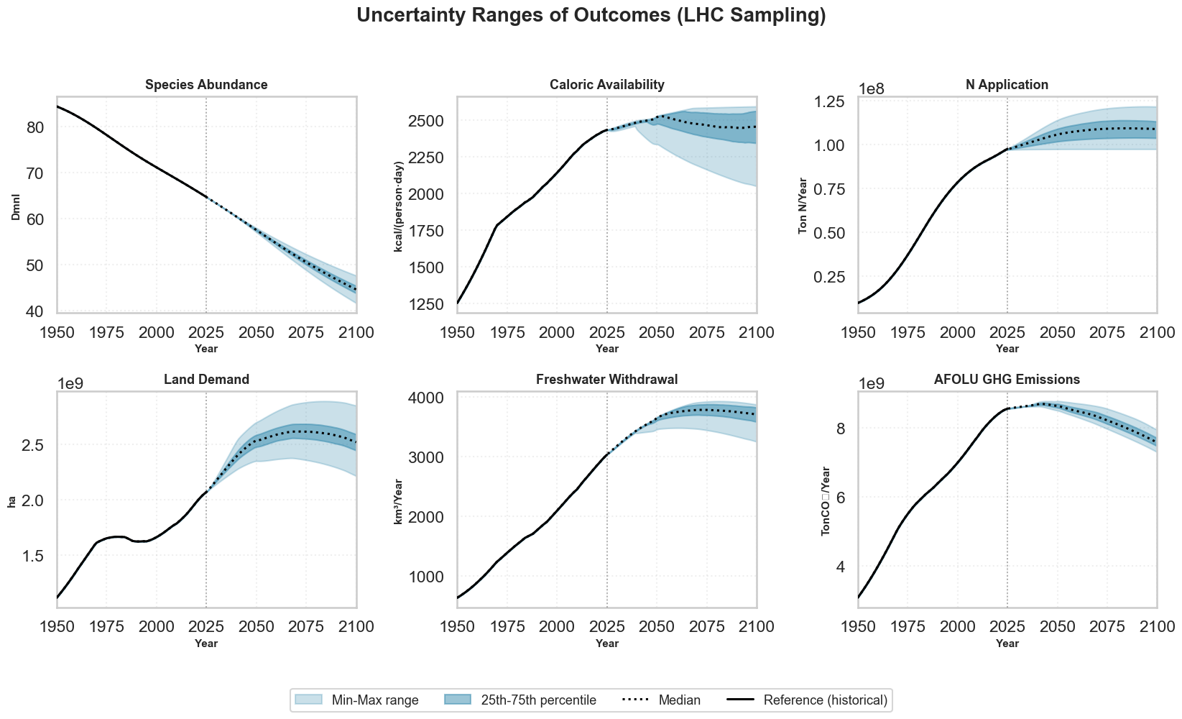
(1) Some outcomes are more “uncertain” than others
Notes:
This feedback uncertainty affects some outcomes more than others. (cus of inclusion/exclusion of feedbacks)

Slide 11
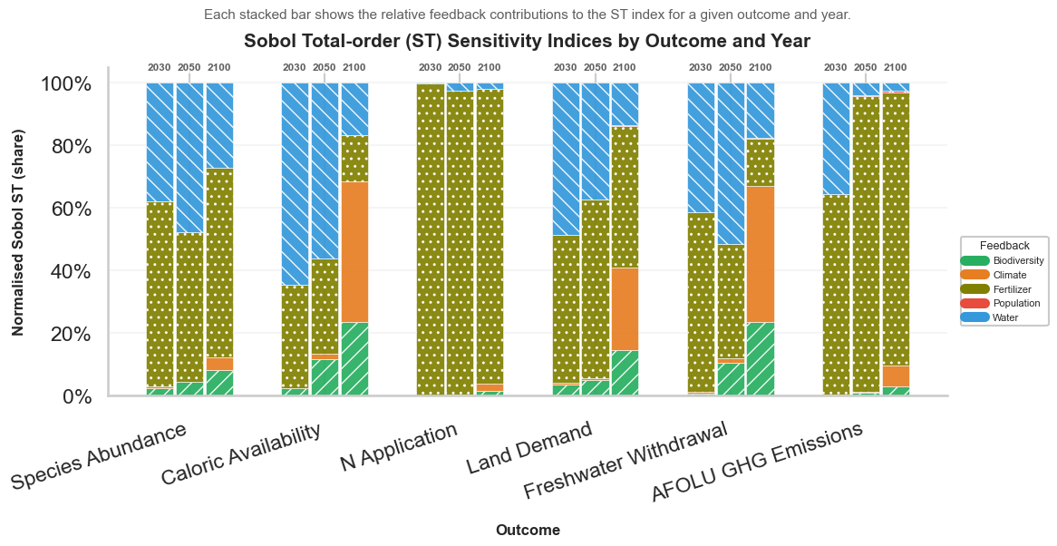
(2) Each outcome uncertainty is explained by different feedbacks
Notes:
Overall structure.
Depending on time horizon, important of feedback changes over time.
Depending on the outcome of focus, different fee
In the food system, those who have relatively lesser feedback strength impacts e.g. climate, population
Interestingly:
Fast intensification feedbacks e.g. fertilizer, water remain dominant in near term
Slow climate-resource couplings in the long term. Poulation and
Implications to Models:
Many models can get away with partial coupling, in the short term but not long term
Direct feedbacks are clearly strong (declines slightly in future)
Fertilisation intensentification is key – mainitains the balance of landuse, calories.
Water extraction increasing importance: early stage
Role of Climate feedback:
Delayed feedback. Also less than expected because emissions from AFOLU isnt realistically as big as other energy/industrial sources.
Role of Biodiversity-Ecosystem Feedback:
It’s not THE dominant feedback but steadily contributes to most objectives.
Emphasise its role as system resilience rather than immediate productivity
“Less” important Feedbacks
Population and Climate* Not because its not a driver, but the food system isnt much of a driver e.g
Interaction effects in general:
- Important in the Medium term (see s1-st divergence in 2050) especially on caloric and freshwater – related to

Slide 12
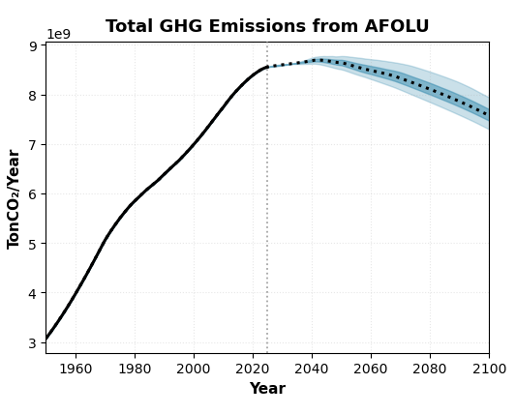
(2) Each outcome uncertainty is explained by different feedbacks
Different feedback matters for different outcomes.
(E.g. Models focused on emissions are concerned about agricultural activities, i.e. fertilizer use)
The model structure is biased to its main outcome of interest.
2030, 2050, 2100
Notes:
Overall structure.
Depending on time horizon, important of feedback changes over time.
Depending on the outcome of focus, different fee
In the food system, those who have relatively lesser feedback strength impacts e.g. climate, population
Interestingly:
Fast intensification feedbacks e.g. fertilizer, water remain dominant in near term
Slow climate-resource couplings in the long term. Poulation and
Implications to Models:
Many models can get away with partial coupling, in the short term but not long term
Direct feedbacks are clearly strong (declines slightly in future)
Fertilisation intensentification is key – mainitains the balance of landuse, calories.
Water extraction increasing importance: early stage
Role of Climate feedback:
Delayed feedback. Also less than expected because emissions from AFOLU isnt realistically as big as other energy/industrial sources.
Role of Biodiversity-Ecosystem Feedback:
It’s not THE dominant feedback but steadily contributes to most objectives.
Emphasise its role as system resilience rather than immediate productivity
“Less” important Feedbacks
Population and Climate* Not because its not a driver, but the food system isnt much of a driver e.g
Interaction effects in general:
- Important in the Medium term (see s1-st divergence in 2050) especially on caloric and freshwater – related to

Slide 13
Dominant Drivers are not static.
Fertiliser and Water are important near-term (production intensification)
Climate and Biodiversity Feedbacks are important in the long-term (environmental feedbacks)
(3) Feedback importance changes over time
Notes:
Overall structure.
Depending on time horizon, important of feedback changes over time.
Depending on the outcome of focus, different fee
In the food system, those who have relatively lesser feedback strength impacts e.g. climate, population
Interestingly:
Fast intensification feedbacks e.g. fertilizer, water remain dominant in near term
Slow climate-resource couplings in the long term. Poulation and
Implications to Models:
Many models can get away with partial coupling, in the short term but not long term
Direct feedbacks are clearly strong (declines slightly in future)
Fertilisation intensentification is key – mainitains the balance of landuse, calories.
Water extraction increasing importance: early stage
Role of Climate feedback:
Delayed feedback. Also less than expected because emissions from AFOLU isnt realistically as big as other energy/industrial sources.
Role of Biodiversity-Ecosystem Feedback:
It’s not THE dominant feedback but steadily contributes to most objectives.
Emphasise its role as system resilience rather than immediate productivity
“Less” important Feedbacks
Population and Climate* Not because its not a driver, but the food system isnt much of a driver e.g
Interaction effects in general:
- Important in the Medium term (see s1-st divergence in 2050) especially on caloric and freshwater – related to

Slide 14
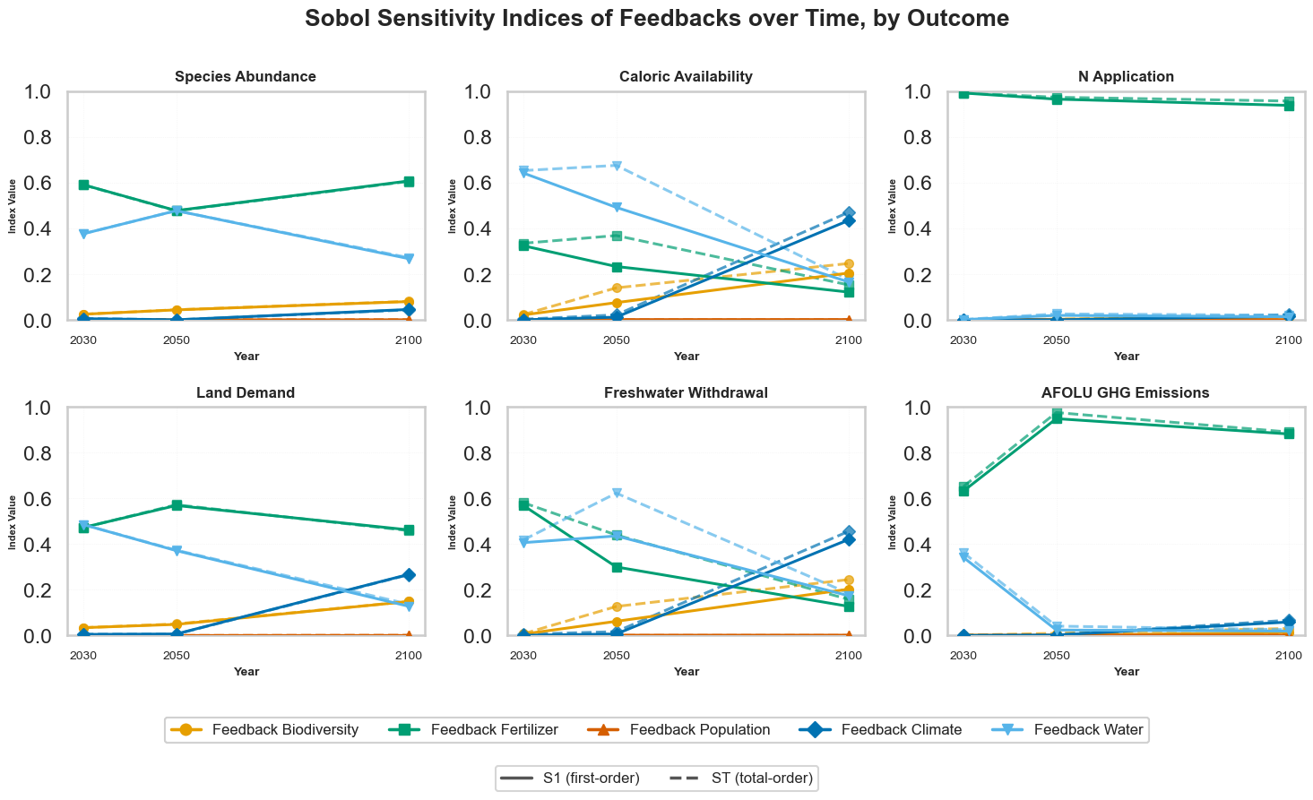
(4) Interacting Effects are important in Medium-Term
Feedback interaction effects peaks in the mid-term future.
Caloric availability involves interactions between resource constraints and environmental responses
Growing system coupling (e.g biodiversity and climate) and presence of tipping behaviours
Notes:
Overall structure.
Depending on time horizon, important of feedback changes over time.
Depending on the outcome of focus, different fee
In the food system, those who have relatively lesser feedback strength impacts e.g. climate, population
Interestingly:
Fast intensification feedbacks e.g. fertilizer, water remain dominant in near term
Slow climate-resource couplings in the long term. Poulation and
Implications to Models:
Many models can get away with partial coupling, in the short term but not long term
Direct feedbacks are clearly strong (declines slightly in future)
Fertilisation intensentification is key – mainitains the balance of landuse, calories.
Water extraction increasing importance: early stage
Role of Climate feedback:
Delayed feedback. Also less than expected because emissions from AFOLU isnt realistically as big as other energy/industrial sources.
Role of Biodiversity-Ecosystem Feedback:
It’s not THE dominant feedback but steadily contributes to most objectives.
Emphasise its role as system resilience rather than immediate productivity
“Less” important Feedbacks
Population and Climate* Not because its not a driver, but the food system isnt much of a driver e.g
Interaction effects in general:
- Important in the Medium term (see s1-st divergence in 2050) especially on caloric and freshwater – related to

Slide 15
Conclusion
Feedback complexity shape longer-term trajectories;
Biodiversity plays an increasingly prominent role as a driver.
A single objective can work with a limited structure; multiple objectives require a more holistic modelling structure.
Future Work:
Link feedback uncertainty to actions and policies to assess robustness.
More accurate formulation and process representation to explore interaction effects.
Notes:
Provides a systems thinking framework to structural explore cross-sectoral models, objectives.
Future work:
Improve representation – interacting effects
Now we think of this with

Slide 16


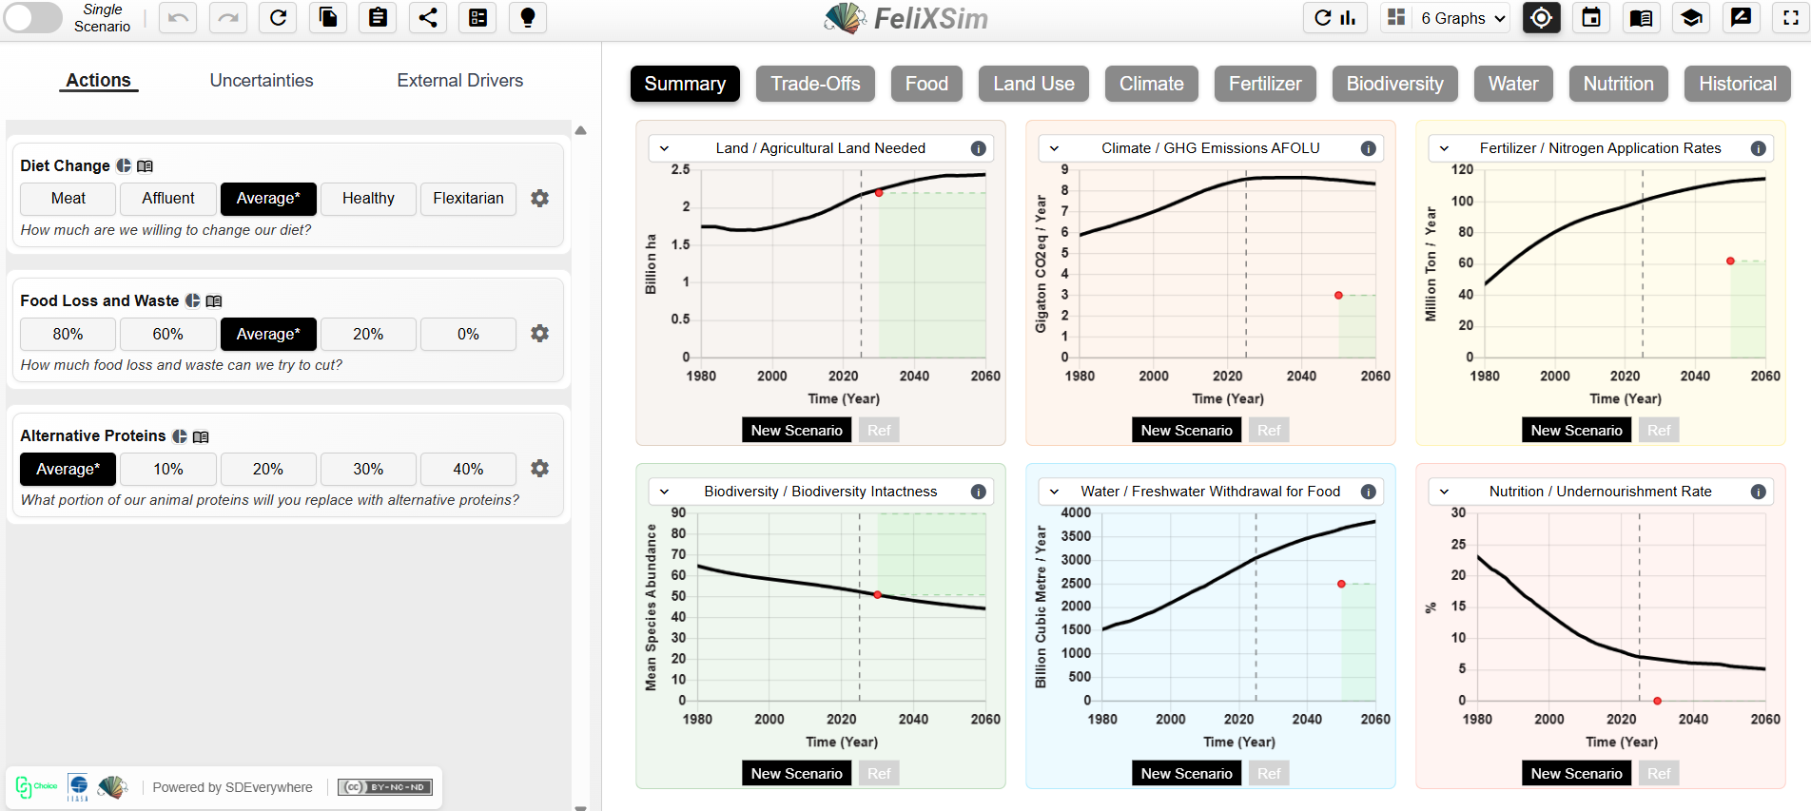
Also, check out our interactive online simulator!
https://climatechoice.github.io/felix/
Thank You!
Any Questions
tanryan@iiasa.ac.at

