Slide 1

Food system transformation in Sub-Saharan Africa: assessing impacts of global pathways on food security, biodiversity, and greenhouse gas emissions
Marta Kozicka, Petr Havlík, David Leclère, Sibylle Rouet-Pollakis, Amanda Palazzo, Yazhen Wu, Felicity Addo, Stefan Frank
International Institute for Applied Systems Analysis (IIASA)
Kyoto, GTAP conference, June 2026

Slide 2
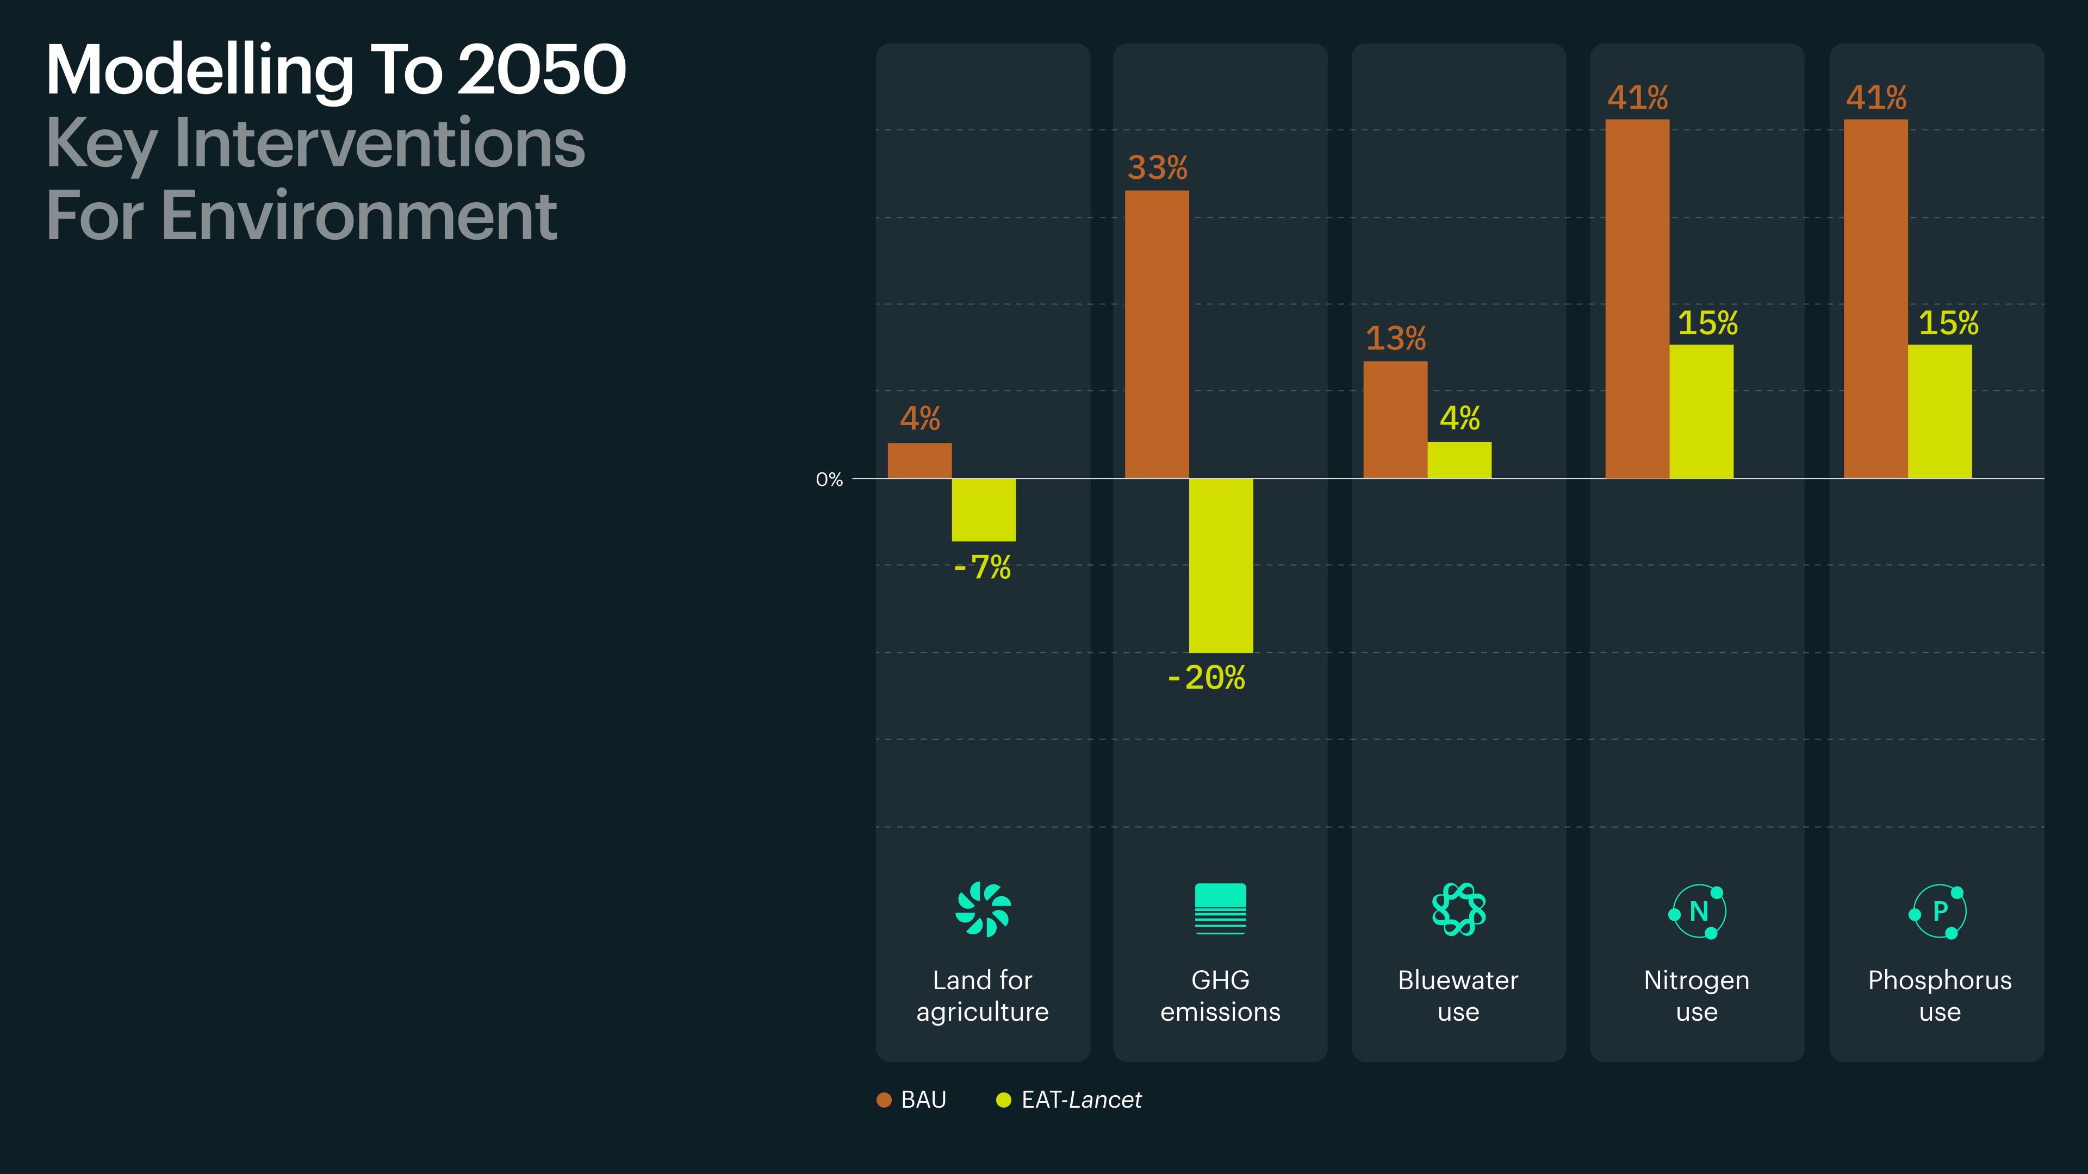

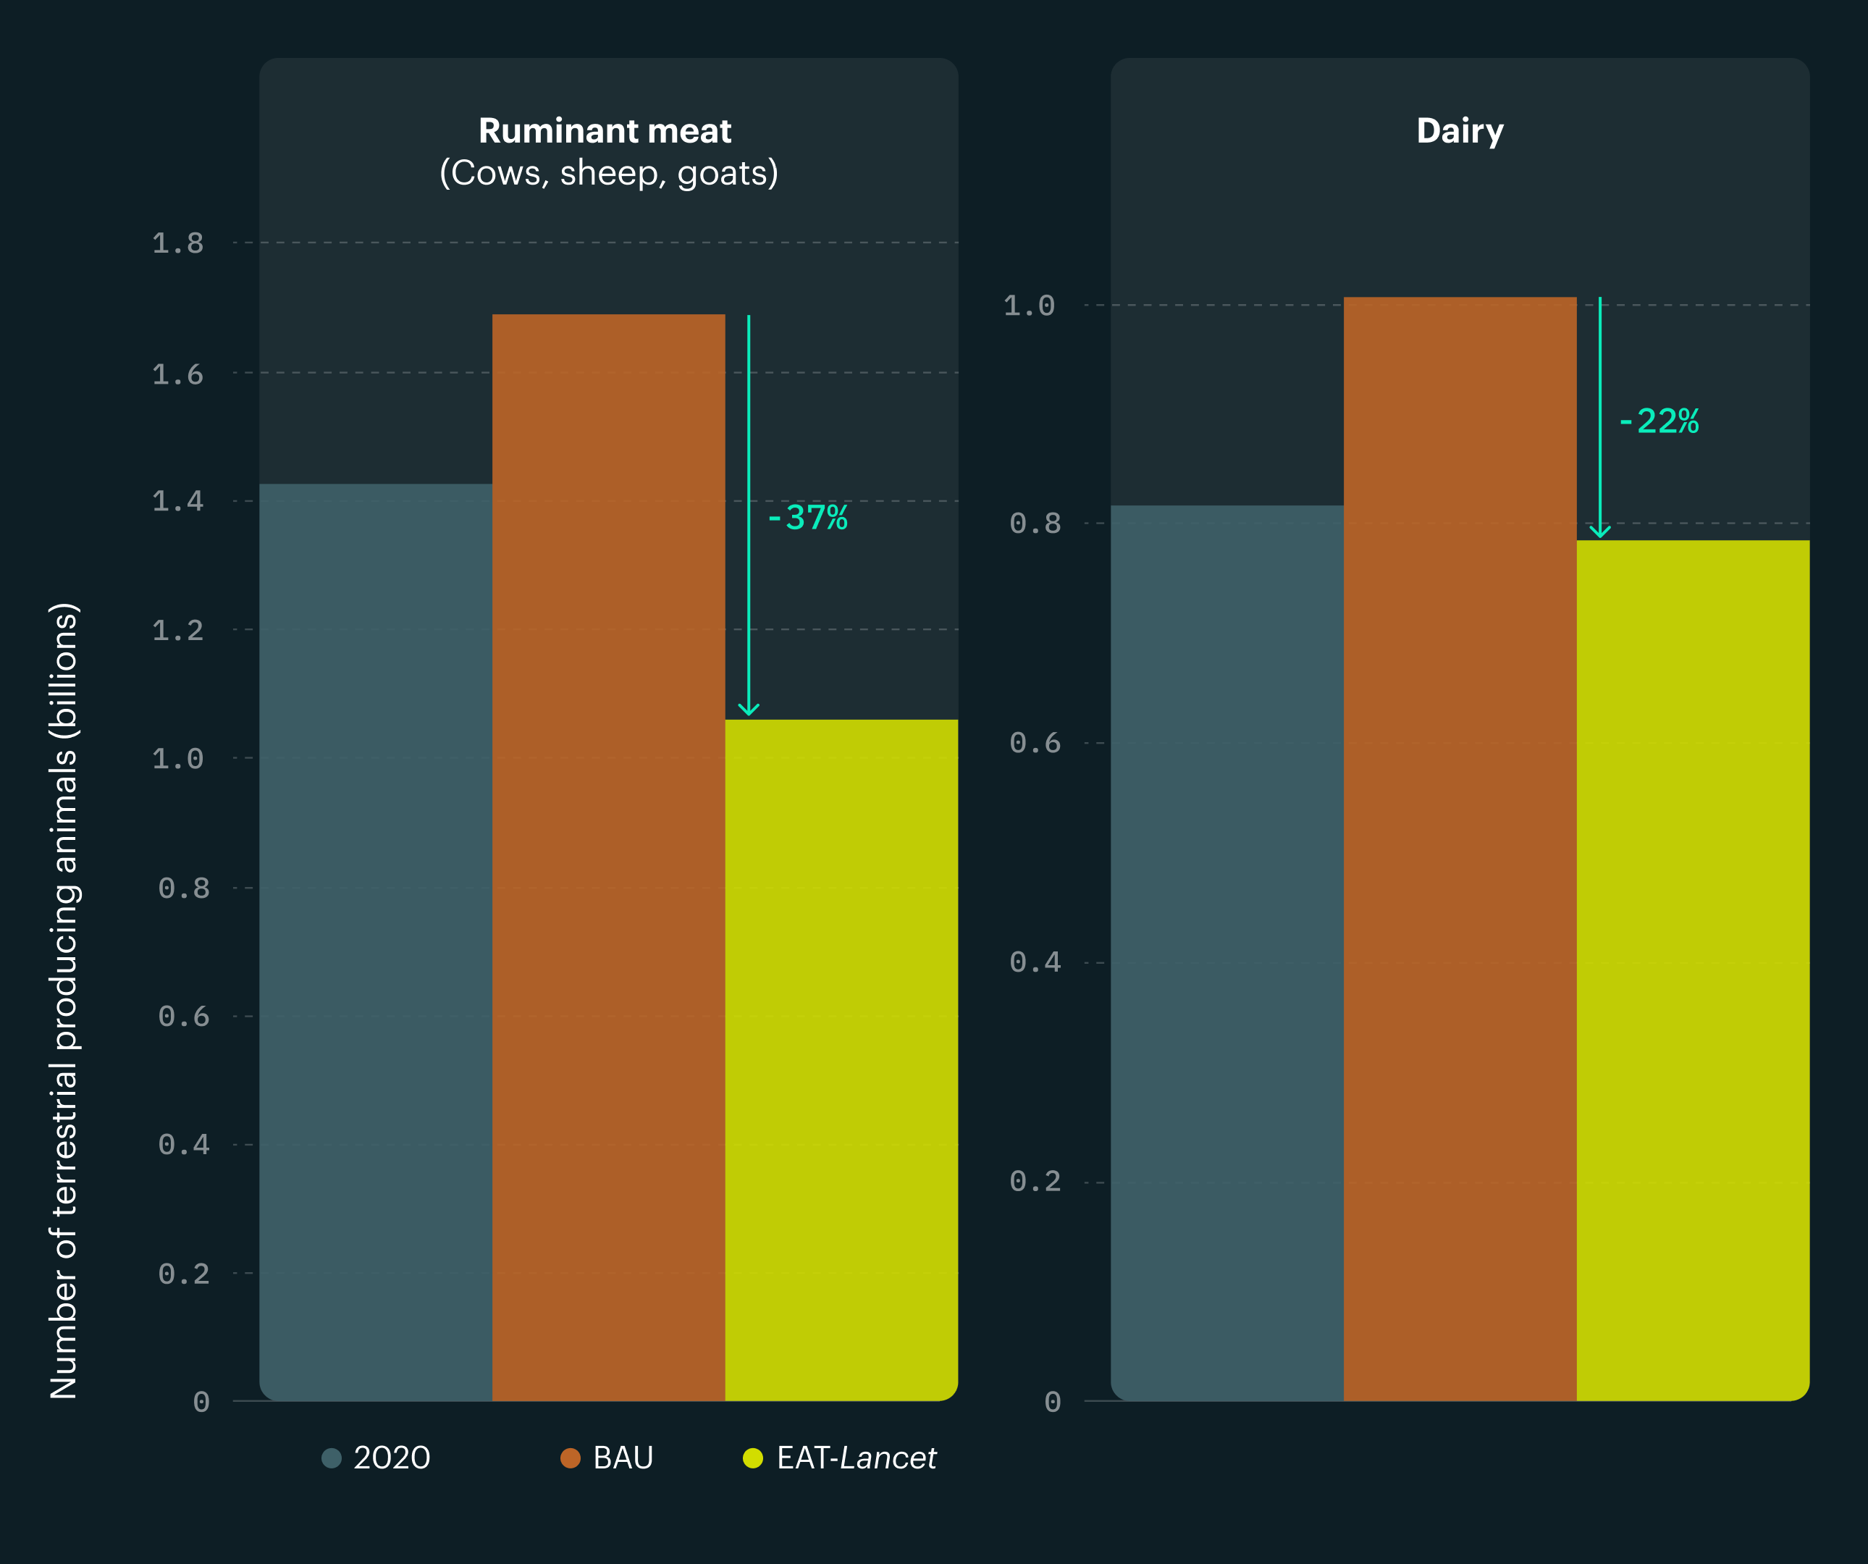
Outline

Slide 3
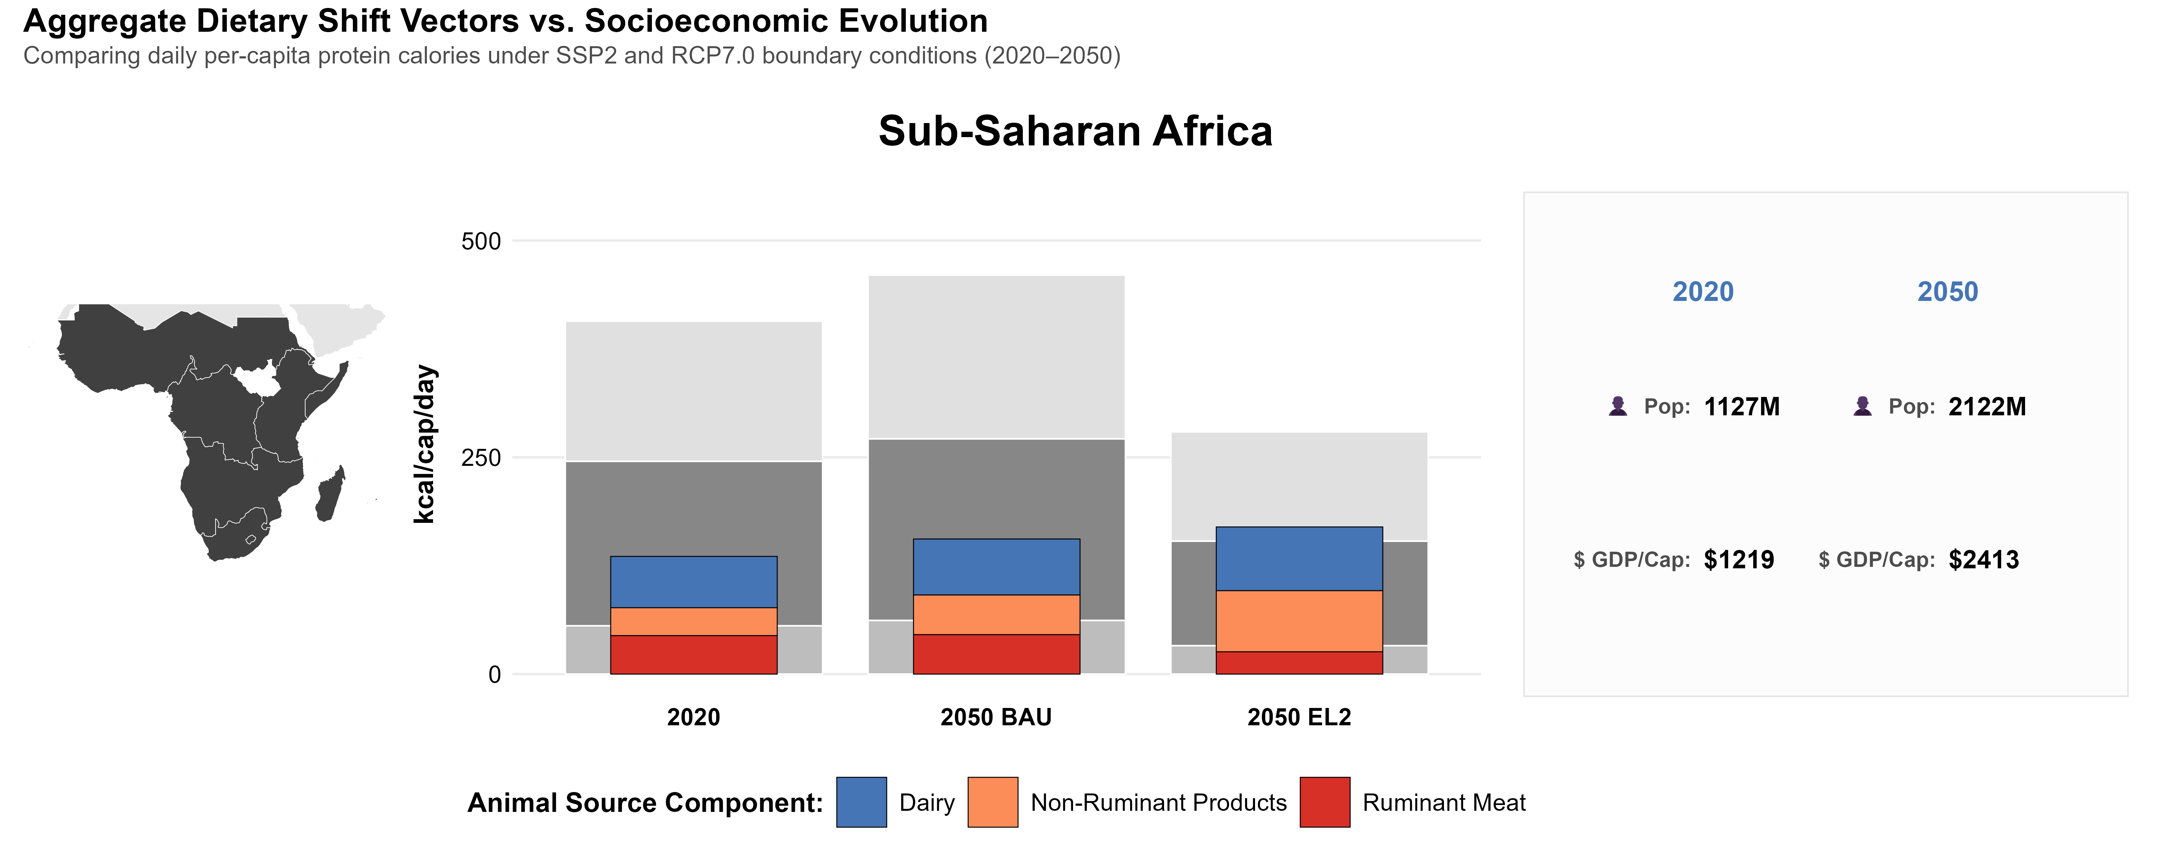
Sub-Saharan Africa – a very different story
Very low ASF consumption
Expected population and income boom
Net food importer structurally exposed to global risks (Kornher et al., 2026; De Vos et al., 2023)
Internal heterogeneity
How would a global food system transformation impact SSA?
World average

Slide 4

Methods
GLOBIOM - a global partial equilibrium economic land use model covering the sectors of agriculture, forestry, and bioenergy.
Key features
Global coverage (59 regions)
Bilateral trade representation
Spatially explicit land-use modelling
Recursive dynamic framework to 2050/2100
10 year time step
Sub-region | Countries
Congo Basin | Central African Republic; DRC; Republic of the Congo; Equatorial Guinea; Gabon; Cameroon
Eastern Africa | Burundi; Ethiopia; Kenya; Rwanda; Tanzania; Uganda
West Africa, Sahel, and the Horn | Benin; Burkina Faso; Cape Verde; Chad; Côte d'Ivoire; Djibouti; Eritrea; Gambia; Ghana; Guinea; Guinea-Bissau; Liberia; Mali; Mauritania; Niger; Nigeria; Senegal; Sierra Leone; Somalia; Sudan; Togo
Southern Africa (excl. RSA) | Angola; Botswana; Madagascar; Malawi; Mozambique; Zambia; Zimbabwe (excluding South Africa)
Republic of South Africa (RSA) | South Africa
Commodity scope: food and feed commodities — 18 crops and 7 livestock product groups – most important for food security. Coffee, cocoa, tea, and some other high-value cash crops — which generate a substantial share of SSA's agricultural export earnings — are excluded.

Slide 5
Methods -scenarios
Code | Title | Key assumptions | Target
BAU | Business-as-Usual | Current trends in population, income, and technology; no new mitigation policies. | Baseline
PROD | Increased Productivity | High investment in agricultural R&D and technology diffusion (consistent with SSP1). | ↑ Yields & feed efficiency
WAST | Food Loss & Waste Reduction | Reductions across production, processing, retail, and consumption (SDG 12.3). | 50% reduction by 2050
DIET | Diet Shift | Transition toward the EAT–Lancet Planetary Health Diet via demand adjustments. | Planetary Health Diet
EL2 | Bundled Scenario | Simultaneous implementation of PROD, WAST, and DIET. | Systemic synergy
Follow the EAT Lancet report framework
SSP2, RCP 7.0
Gradual adoption reaching 100% in 2050

Slide 6


BAU in 2050: improved food security, at ecological cost
The food security trajectory
Increased energy availability — per capita calorie consumption +34% by 2050; ASF consumption remains low
The food security challenge shifts from food availability to diet quality and affordability
The ecological trajectory
Cropland +44%, GHG +37%, BII −3.3% (twice the global average rate)
Pressures concentrated in Congo Basin and Western Africa, Sahel, and the Horn — globally crucial ecosystems

Slide 7
ASF demand under BAU vs. EL2
in SSA and globally
World average

Slide 8
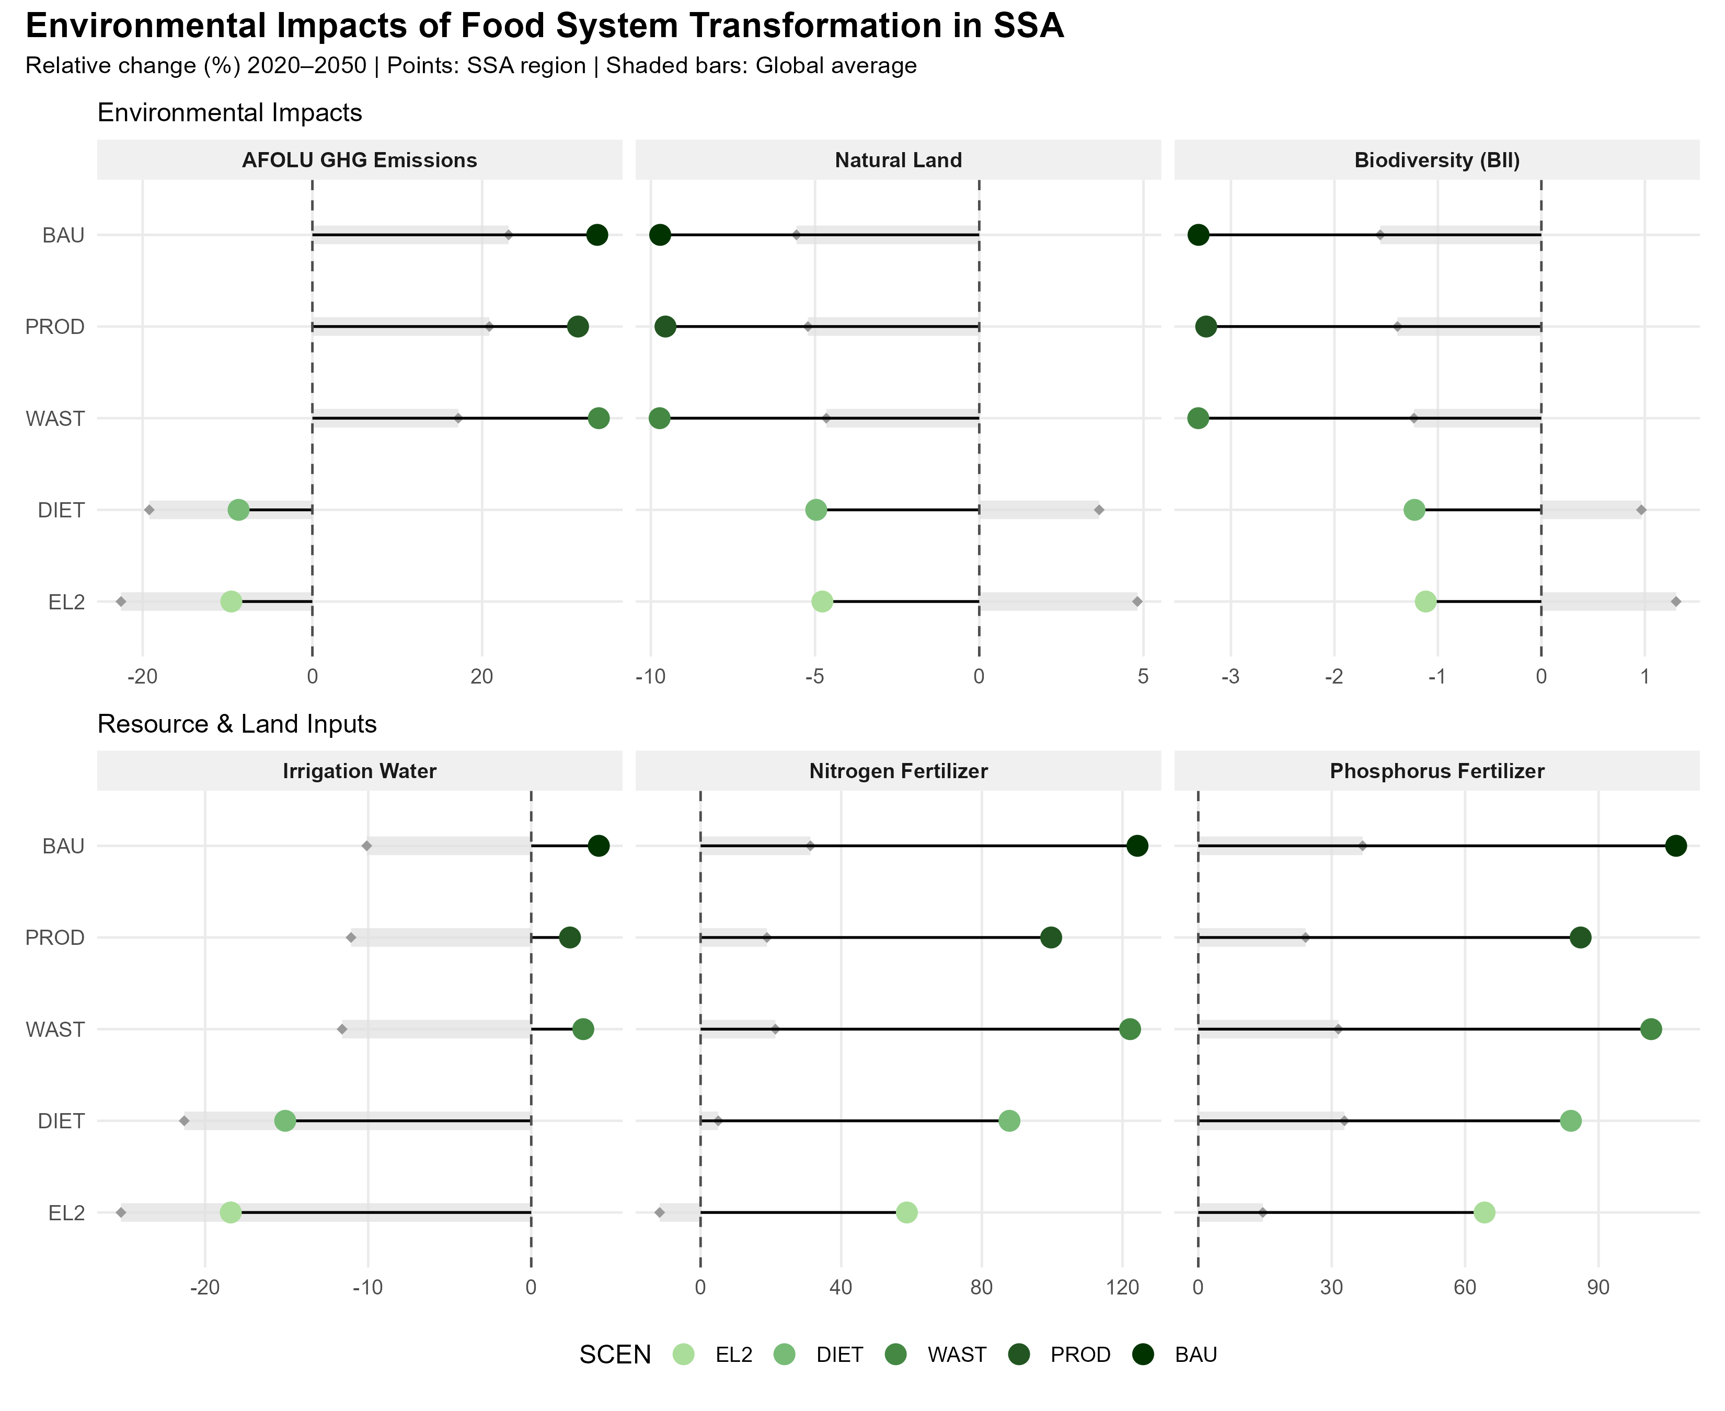
Diet change is key for the environment
Dietary change reduces the pressure on the environment, but in SSA less than global average
Bundling with productivity increase and waste reduction:
very small impact on the environmental outcomes
but some agricultural input use reduction
Notes:
BII measures the average abundance of originally present species in a given area relative to an undisturbed baseline. It is derived from the PREDICTS (Projecting Responses of Ecological Diversity In Changing Terrestrial Systems) framework, which provides empirical relationships between land use and biodiversity responses. BII captures changes in local biodiversity due to land-use conversion and intensification.

Slide 9
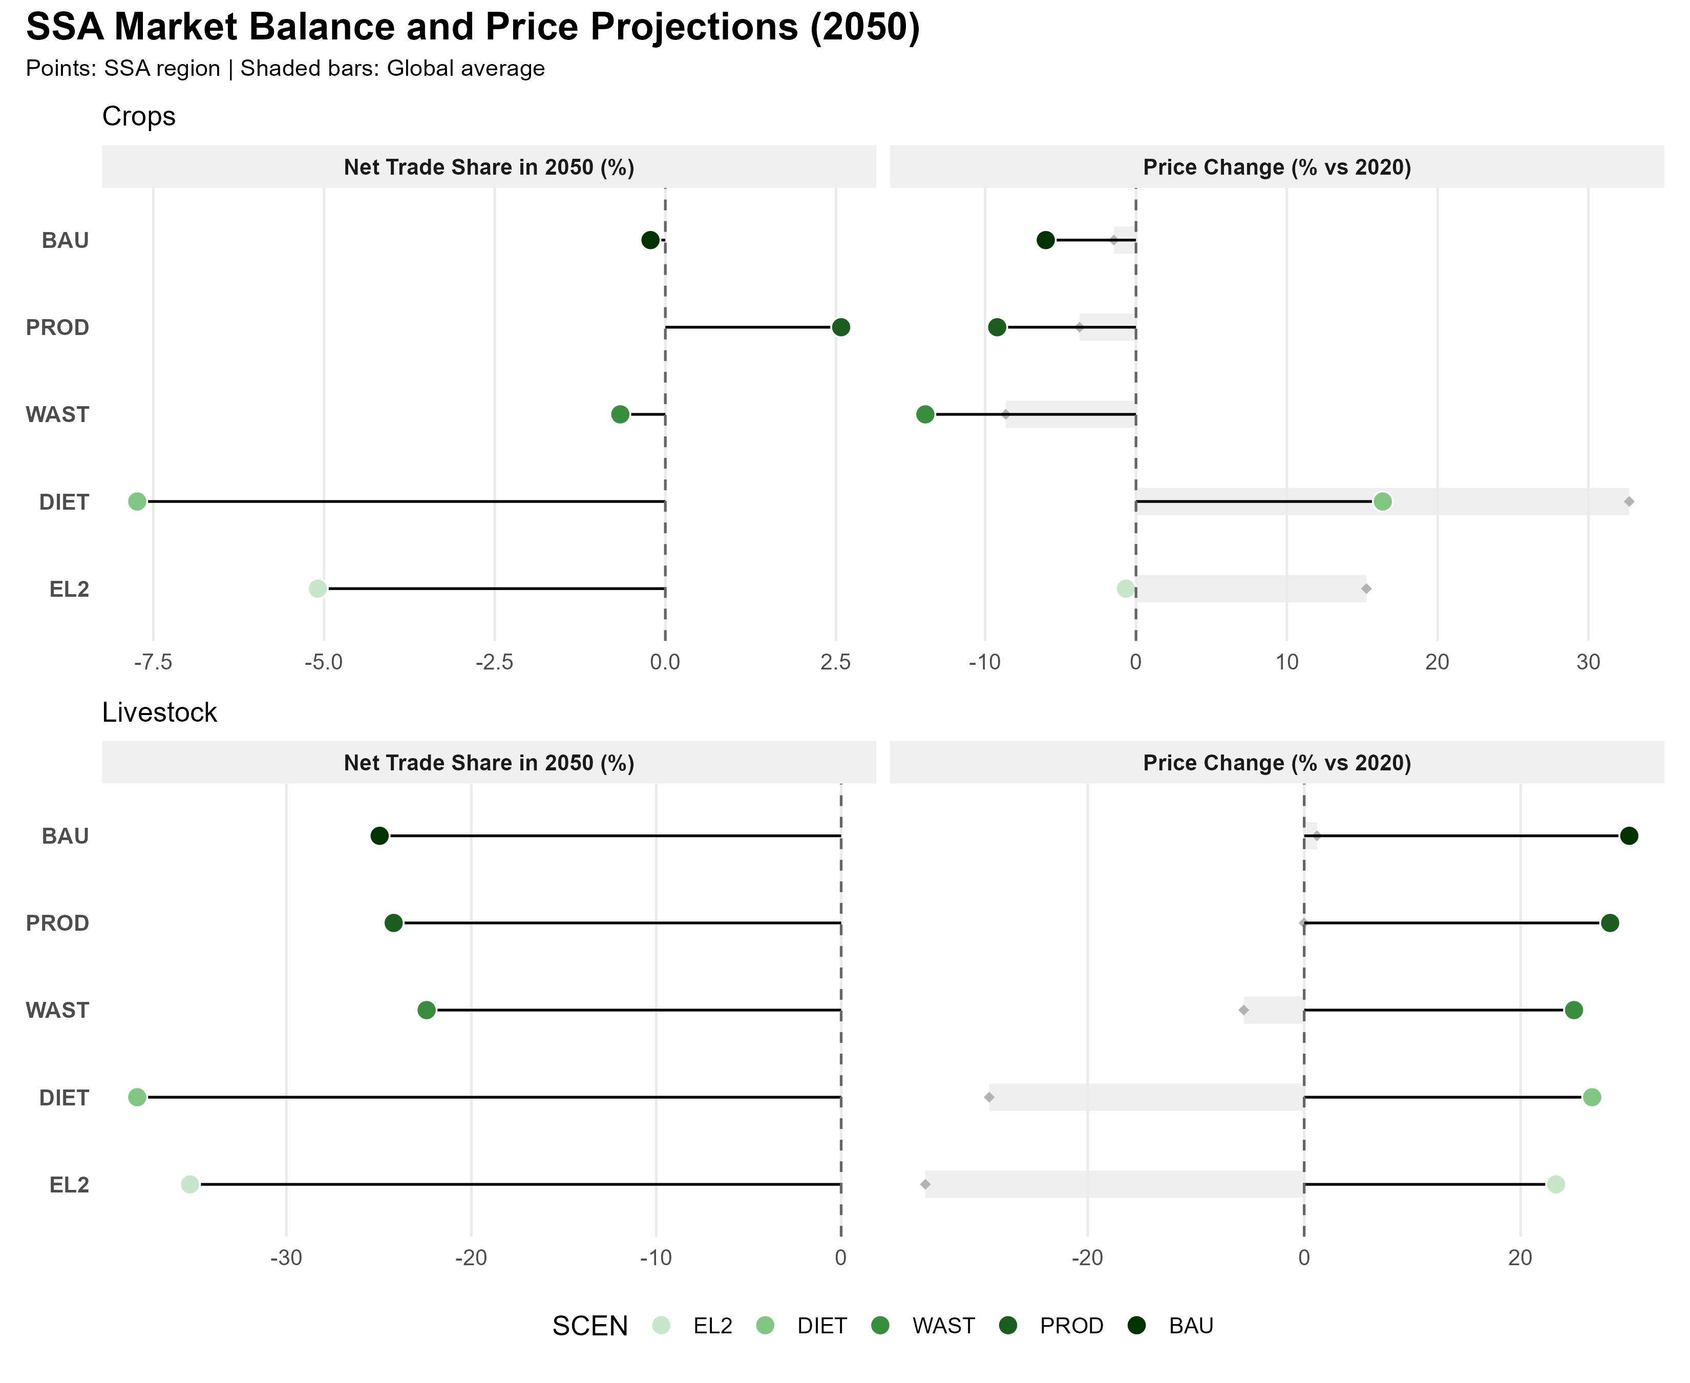
Supply-side interventions buffer the market impacts
Diet change drives import dependence and crop price increases
Bundled scenario reduces those impacts
Notes:
DIET scenario:
Total agricultural net imports: approximately 7× BAU
Overall food prices: +28% vs 2020
Domestic production: −17% vs BAU
Cropland still expands: +32% vs 2020 (just less than BAU's +44%)
EL2 (bundled):
Import surge moderated to approximately 5.4× BAU — a 26% reduction from DIET
Food prices: +11% vs 2020
GHG outcome: identical to DIET — both −41% vs BAU
PROD and WAST contribute zero additional GHG reduction within EL2. Their value is moderating the import surge from 7× to 5.4× and the price signal from +28% to +11%. If you frame EL2 as an environmental strategy, it looks identical to DIET.

Slide 10
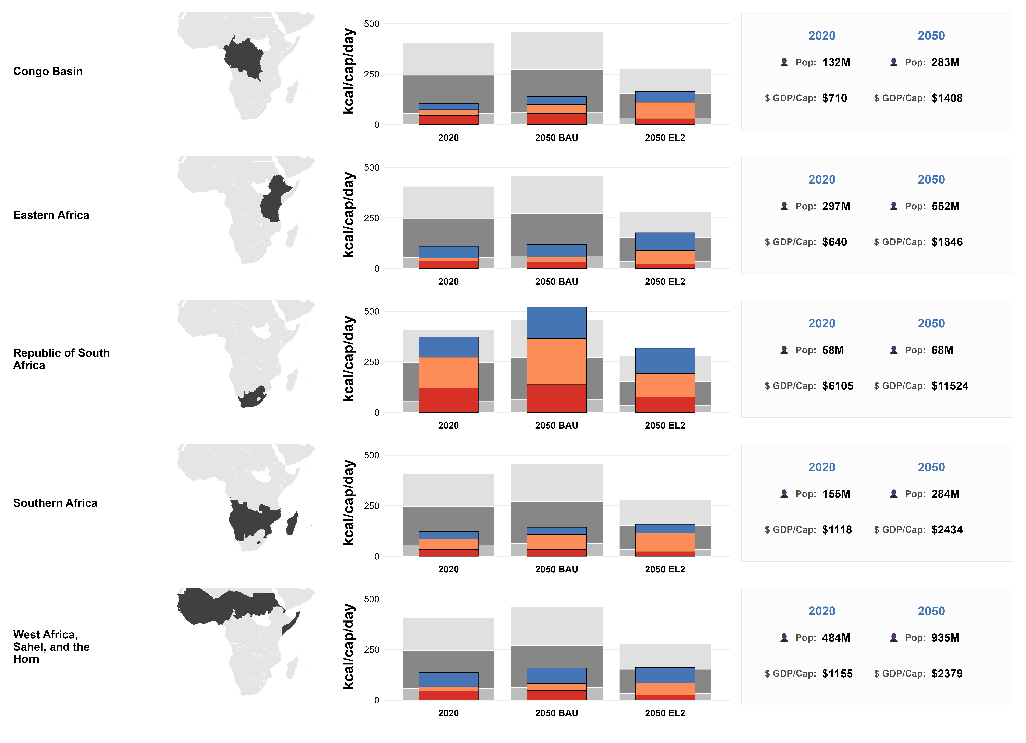
Outline
Heterogeneous region
Republic of South Africa: the only sub-region with ASF reduction under PHD diet
The rest of the sub-regions catch up, but at different speeds

Slide 11
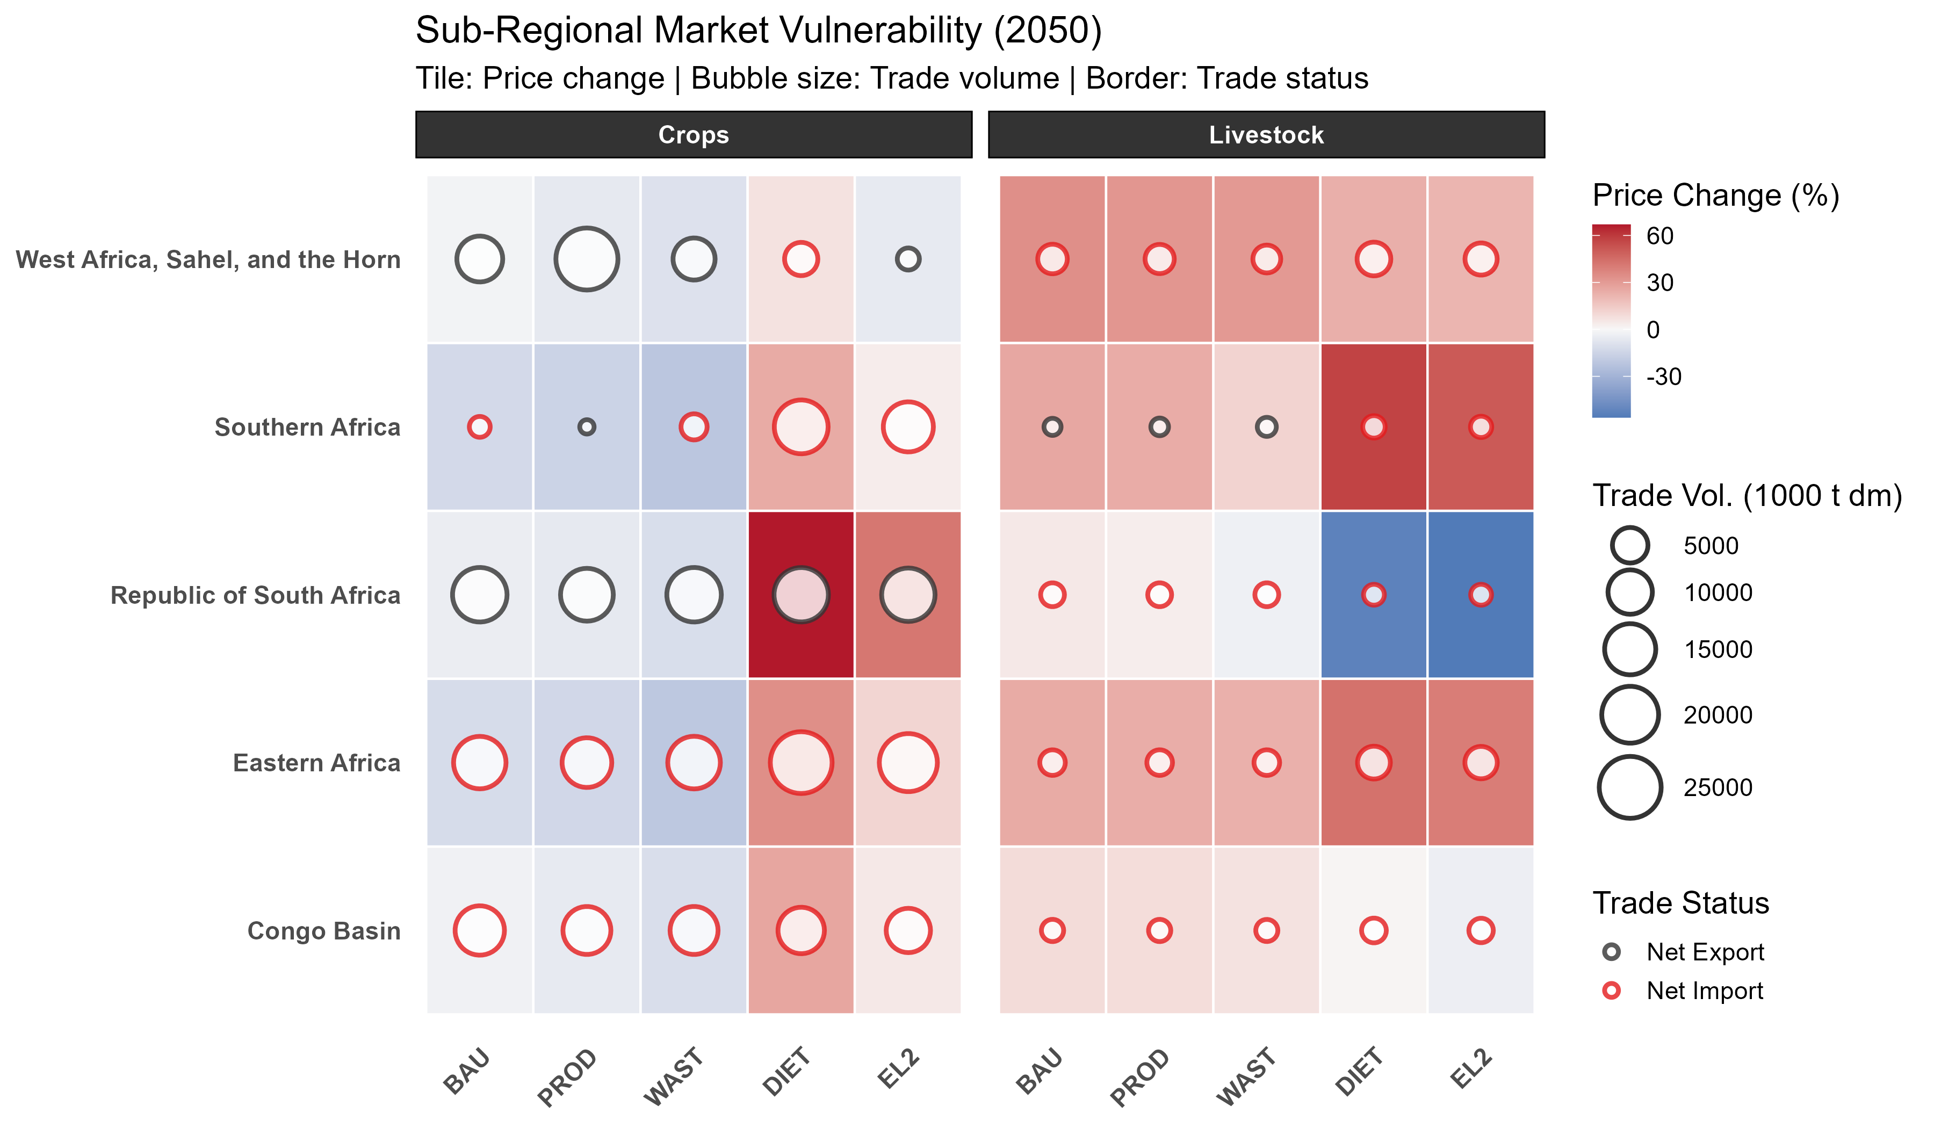
Heterogeneous impacts
Western Africa and RSA: net crop exporters under most scenarios. The intra-regional trade opportunity.
RSA: insulated — the only sub-region not exposed to the livestock import and price surge under dietary transition.
Eastern Africa: deepest import dependency and price increase under DIET and EL2. Structural constraint: demand outpaces production under every scenario.

Slide 12
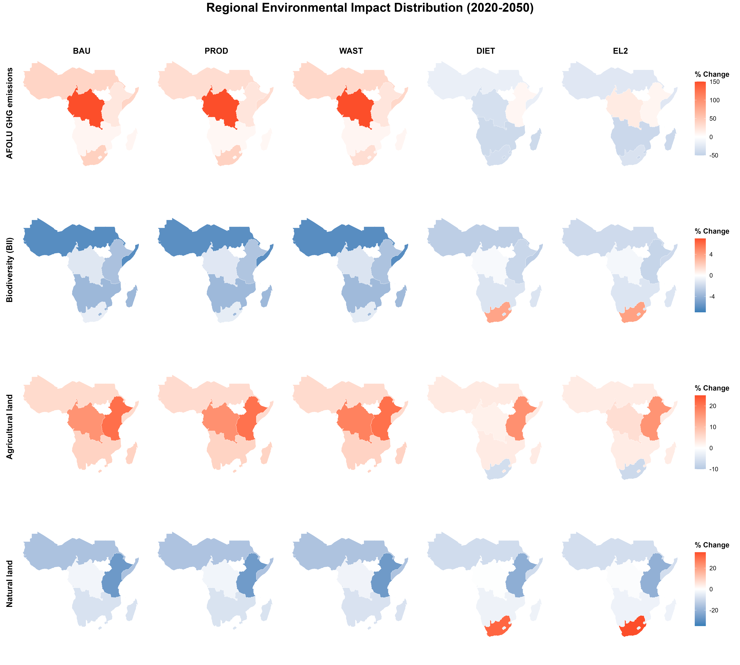
Environmental impacts differ by sub-region too
RSA is the only sub-region that bends the biodiversity curve with diet
AFOLU GHG emissions increase in East Africa in all scenarios
All but RSA increase agricultural land and reduce natural land in all scenarios. East Africa the most!

Slide 13
Conclusions
Global dietary change key to reduce the environmental pressures of more balanced diets in SSA (mainly through higher imports).
Within SSA:
Combining dietary transition with productivity increase and loss reduction measures moderates import dependency, agricultural input use, and the price increase relative to DIET alone.
Intra-regional trade – an opportunity to partially stabilize food supply under DIET and EL2 (Kornher et al., 2026; Janssens, C., Havlík, P., Boere, E., et al., 2022)
Eastern Africa and Congo Basin – with negative impacts on both socio-economic and environmental fronts under all scenarios -> Key regions in need of additional environmental policies and social safety nets.

Slide 14
Thank you!
Marta Kozicka
kozicka@iiasa.ac.at
This research was funded by the European Union's Horizon Europe research and innovation programme under grant agreement No 101081617 (CHOICE).

